Slide 1
EU Policy Context of the EU Peer Review of the Taiwanese Stress Tests
Meeting with the NGOs
Taipei, 25 September 2013
Christian Kirchsteiger
European Commission,
Directorate-General for Energy (DG ENER)

Slide 2
Participants today:
EU Peer Review Team, consisting of:
Representatives of the European Commission
Representatives of ENSREG, an advisory group of the European Commission, consisting of national regulators:
from nuclear EU Member States,
non-nuclear EU Member States,
Switzerland

Slide 3
EU Treaty (2009) – Energy Policy Objectives [Art. 194]
1. In the context of the establishment and functioning of the internal market and with regard for the need to preserve and improve the environment, Union policy on energy shall aim, in a spirit of solidarity between Member States, to:
(a) ensure the functioning of the energy market;
(b) ensure security of energy supply in the Union;
(c) promote energy efficiency and energy saving and the development of new and renewable forms of energy; and
(d) promote the interconnection of energy networks.
2. … Such measures shall not affect a Member State's right to determine the conditions for exploiting its energy resources, its choice between different energy sources …

Slide 4
EU Energy Policy Objectives
Competitiveness
Security of Supply
Climate Protection

Slide 5
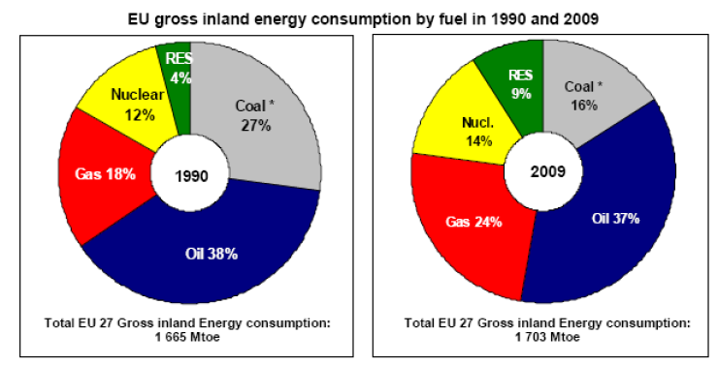
Current EU Energy Mix is not sustainable

Slide 6
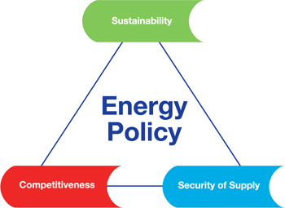
Energy policy for Europe
Year 2020 objectives:
increase energy efficiency by 20%
reduce CO₂ emissions by 20%
increase the share of renewable sources to 20%
2030 framework for climate and energy policies: what after 2020?
Energy Roadmap 2050: decarbonisation

Slide 7
Energy Roadmap 2050: a basis for a long-term policy framework
European Council
Aim of the Roadmap
EU objective for 2050 – GHG emissions down to 80-95% below 1990 levels
Explore routes towards a low-carbon energy system by 2050 which improve competitiveness and security of supply
Notes:
On European Council:
EU objective for 2050: reduction in GHG emissions to 80-95% below 1990 level by 2050, in the context of necessary reductions by developed countries as a group, according to the Intergovernmental Panel on Climate Change
On the aim of the Roadmap:
The Roadmap is part of a process to shape a common view in Europe on how we can achieve the transformation of our energy system, meeting the established trio of objectives. Looking for “no regrets” policy options. Develop 2030 policy framework including concrete milestones (for predictability).
We have a shared interest in achieving and communicating a clear picture on the policy framework, especially in this time of uncertainties and turbulence. It does not matter whether policy uncertainties are at Member State or EU level – the effect on investment risks will be much the same.
May 2011, Informal Energy Council: The Roadmap "should stand as the commonly accepted and ambitious – but at the same time feasible – foundation for the long-term European energy policy".

Slide 8
Renewables move centre stage, but all fuels can contribute in the long-run
Decarbonisation scenarios (80& GHG reduction by 2050) - fuel ranges (primary energy consumption in %)
2030
2050
75%
75%
2005
50%
50%
25%
25%
0%
0%
RES
Gas
Nuclear
Oil
Solid fuels
RES
Gas
Nuclear
Oil
Solid fuels
Notes:
RES dominates energy mix in long-run. 2030 shows already significant increases in RES. If it were measured in final demand – as in RES directive – this would go up to around 30%. In electricity generation, RES share by 2030 would be between 51 and 60%. In 2050, RES dominates the energy mix by far. High RES scenario has 65 percentage points more RES in final demand than today reaching 75%.
Gas will be critical for the transformation of the energy system. Substitution of coal (and oil) with gas in the short to medium term could help to reduce emissions with existing technologies until at least 2030 or 2035. Although gas demand in the residential sector, for example, might drop by a quarter until 2030 due to several energy efficiency measures in the housing sector, it will stay high in the power sector over a longer period. In the Diversified Supply Technologies scenario for example, gas-fired power generation accounts for over 1000 TWh in 2050, significantly higher than current levels.
Nuclear energy will be needed to provide a significant contribution in the energy transformation process in those Member States where it is pursued. It remains a key source of low carbon electricity generation.
Oil is likely to remain in the energy mix even in 2050 and will mainly fuel parts of long distance passenger and freight transport.
Coal in the EU adds to a diversified energy portfolio and contributes to security of supply. With the development of CCS, coal could continue to play an important role in a sustainable and secure supply in the future.

Slide 9
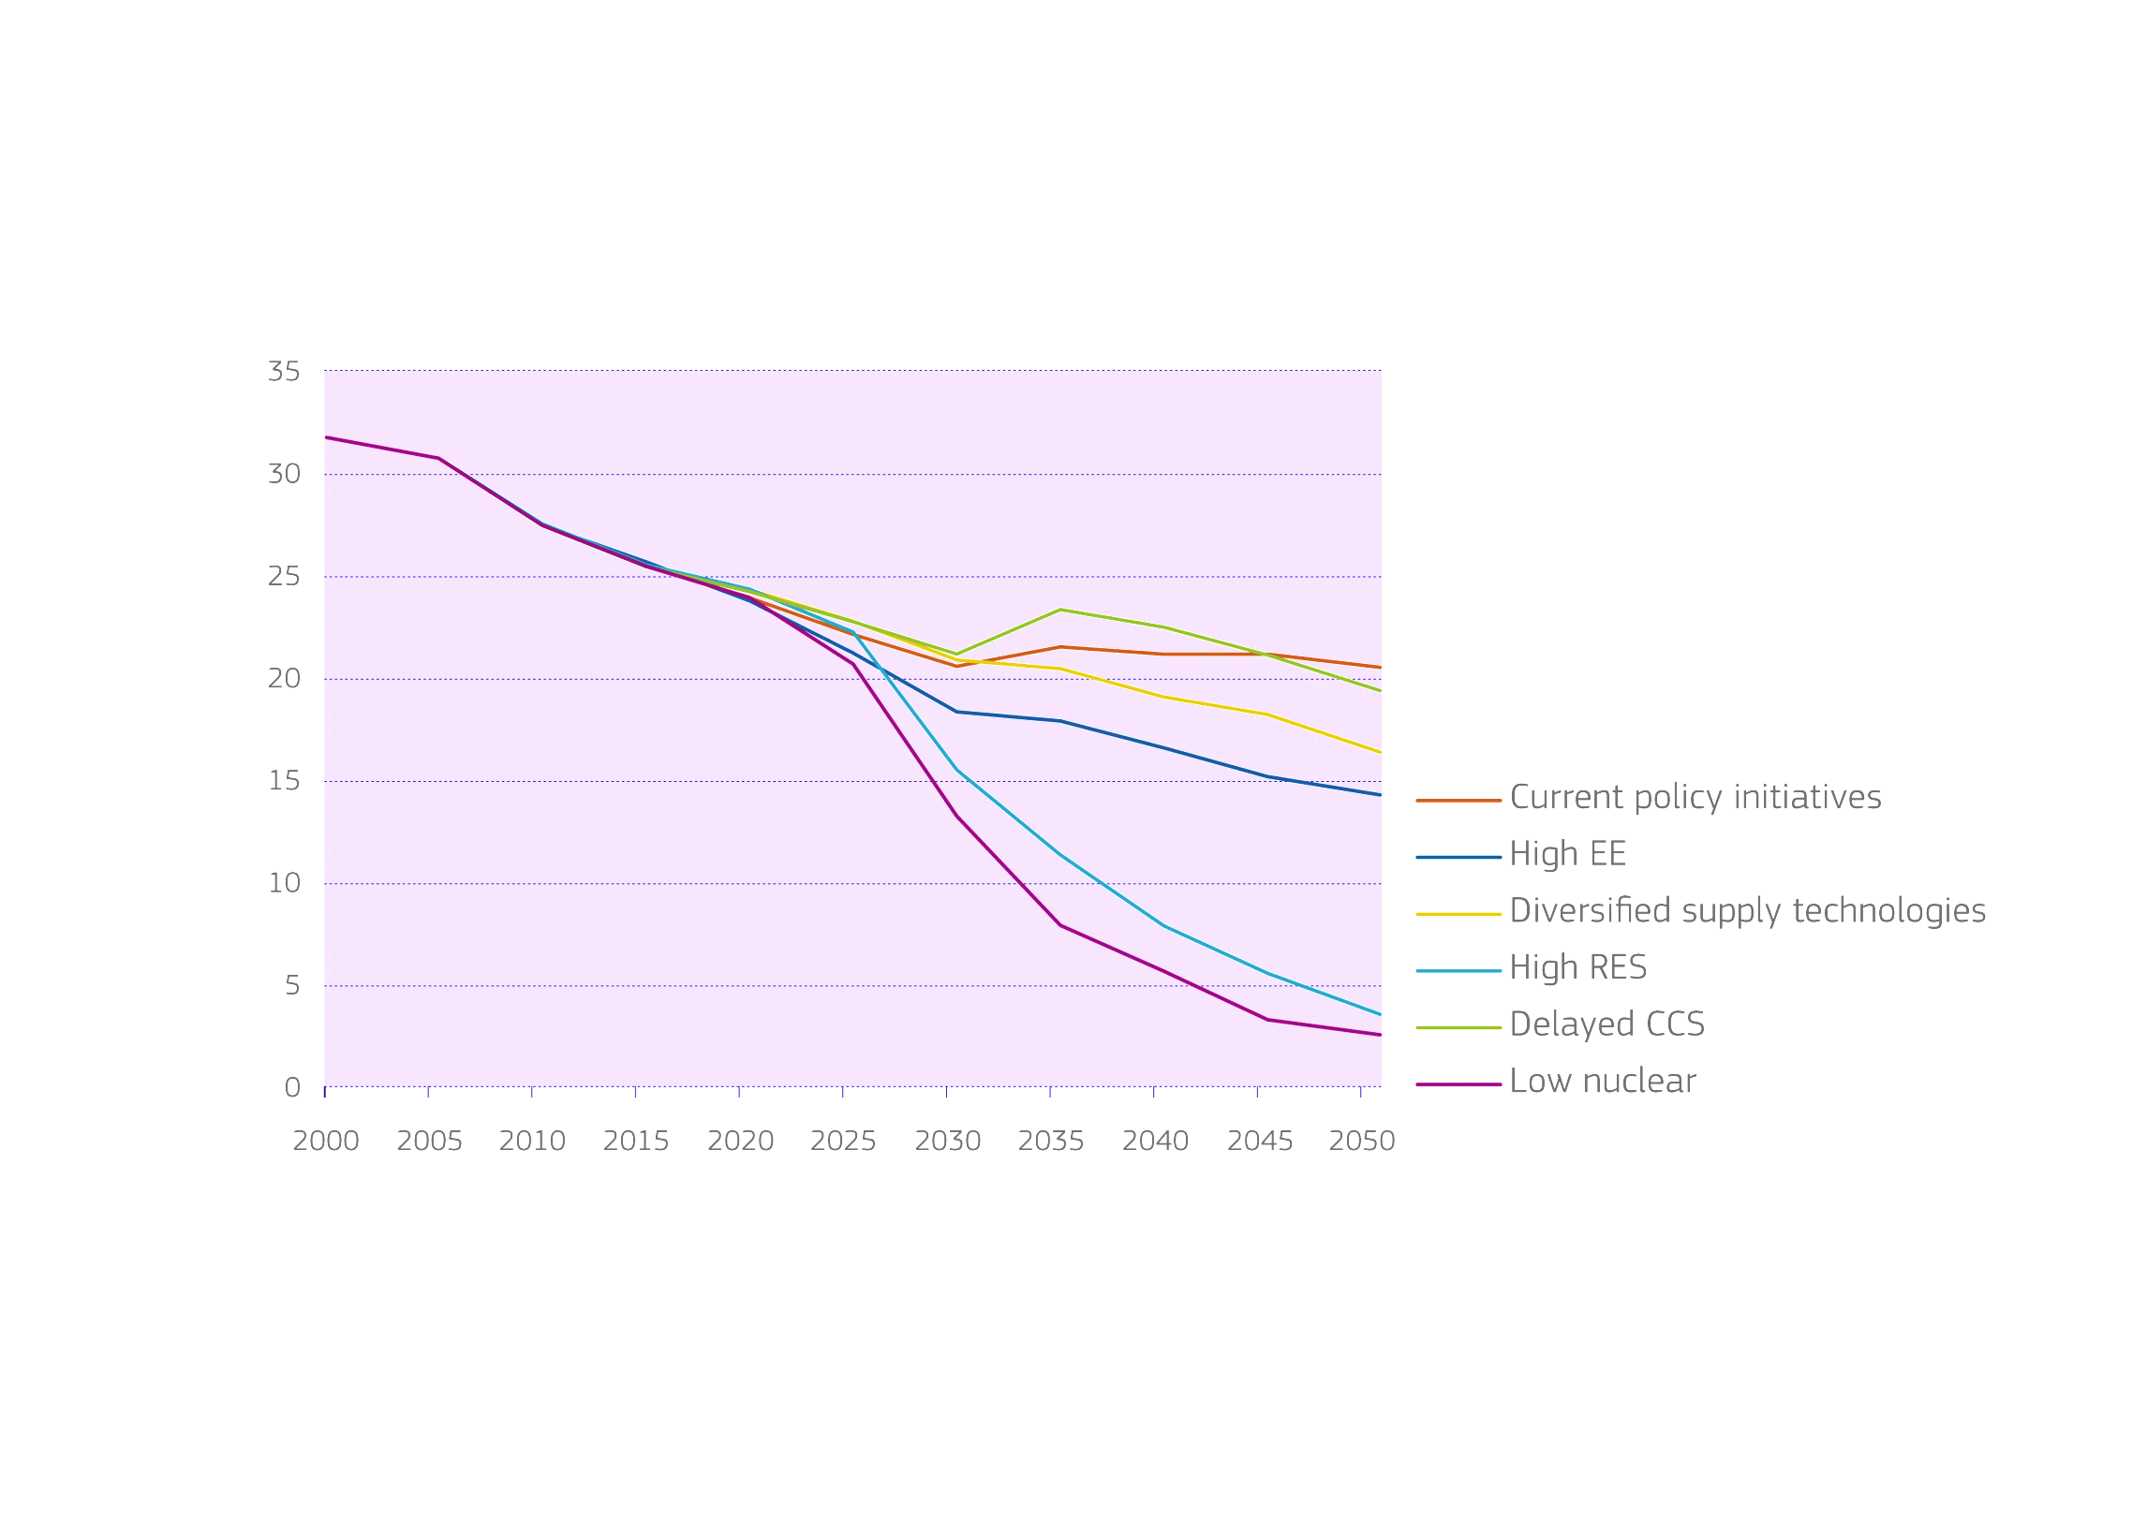
Role of nuclear energy depends on scenario
Share of nuclear in power generation (in %)
Source: European Commission
Nuclear production will contribute more or less, depending on the scenario. 80% GHG reduction can also be achieved with a very low nuclear contribution.

Slide 10
The Way Forward
2020 strategy (20-20-20) – precondition
No regret options:
energy efficiency,
renewable energy,
more and smarter infrastructure
Need for fully integrated, well-designed markets for gas and electricity
Nuclear safety
Notes:
The Roadmap 2050 does not provide all the answers, but is a milestone in the ongoing dialogue with other EU institutions, Member States and stakeholders on the future policy direction. It is an incentive to define the 2030 policy framework.

Slide 11
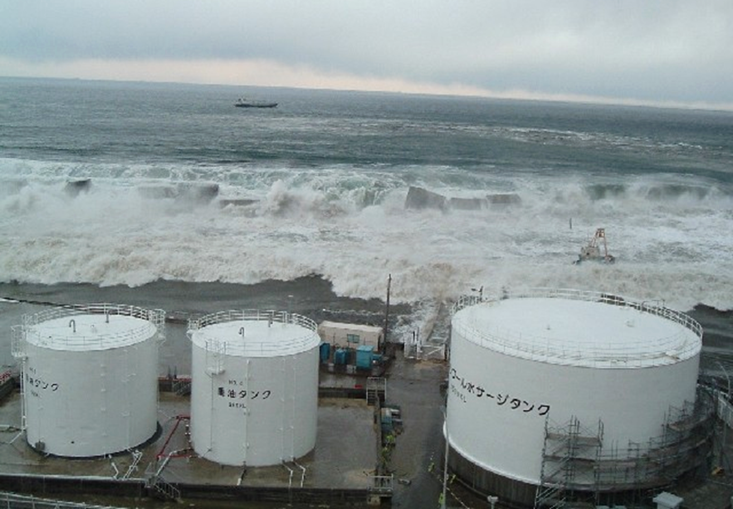
11 March 2011

Slide 12
State of play
Germany: exit by 2022
Belgium and (Switzerland): phase-out
Italy: reintroduction rejected
Others: no major changes
Ongoing projects: France, Finland
Possible new projects: UK, CZ, Poland…

Slide 13
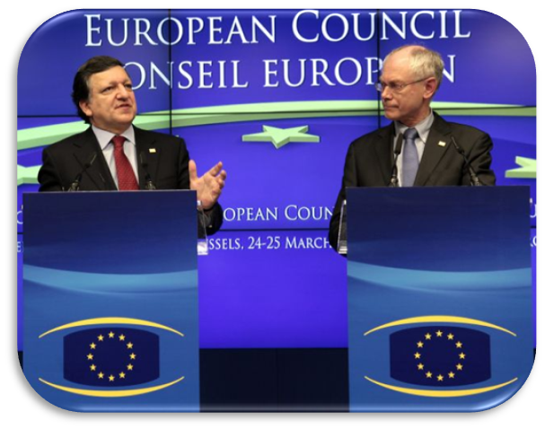
EU-Stress Tests: Mandate
Commission Mandate:
15 March 2011: High Level Conference of Member States
24-25 March 2011: European Council:
comprehensive and transparent risk and safety assessments ("Stress Tests") together with ENSREG
similar stress tests should be carried out in the neighbouring countries and worldwide
revision of the legal and regulatory framework

Slide 14
Stress Tests: Two Lines of Work
2 mandates from the European Council after the Fukushima accident
Carry out, together with ENSREG, EU-wide comprehensive risk and safety assessments of nuclear power plants ("stress tests")
Review the legal and regulatory framework for the safety of nuclear installations and propose improvements

Slide 15
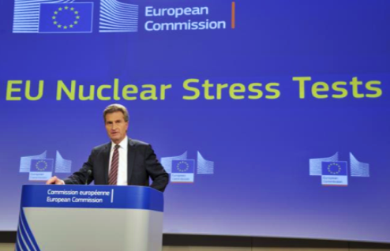
Stress tests: results
ENSREG report on peer reviews (April 2012):
Significant and tangible improvements identified in all participating countries; remedial measures implemented or planned
Commission final report (October 2012):
High level of safety, no immediate closure needed
Significant and tangible improvements identified in all participating countries; remedial measures implemented or planned
Weaknesses in frameworks and procedures and gaps in legal arrangements; proposals to improve are being prepared

Slide 16
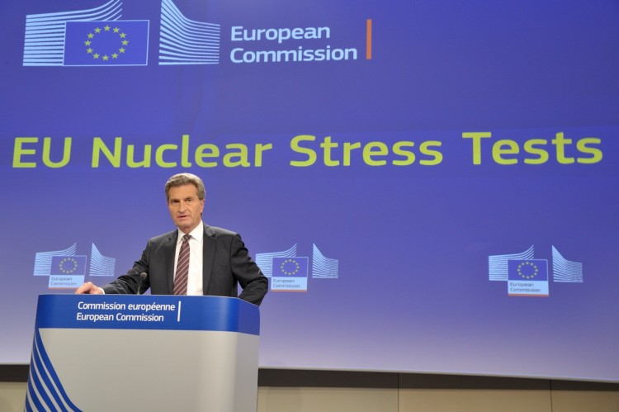
Before Fukushima
Nuclear Safety Directive (2009)
Nuclear Waste Directive (2011)
After Fukushima
EU Council Mandate
Stress Tests, Peer Reviews,
National Action Plans,
Neighbouring countries.
New Nuclear Safety Directive
Insurance and Liability
Emergency Preparedness & Response
Notes:
BACKGROUND
Nuclear Safety Directive (2009)
EU-wide legally binding framework
Reflects international instruments:
Convention on Nuclear Safety
IAEA Safety Fundamentals
Content features:
Establishes national responsibility for nuclear safety
Reinforces regulatory authorities
Transparency (principles)
Nuclear Waste Directive (2011)
Key features:
legally binding standards for management of radioactive waste and spent fuel
strict conditions on exports outside the EU
promotes public information and participation
Main bases:
IAEA Safety Standards
Joint Convention on the safety of spent fuel and radioactive waste management
European Council mandate (March 2011)
Participation: all 14 EU MSs with nuclear plants + Lithuania, Switzerland & Ukraine
Commission final report (October 2012):
high level of safety, no urgent decisions needed
significant and tangible improvements; weaknesses in frameworks and procedures and gaps in legal arrangements
National action plans (end 2012)
Peer review of national plans (April 2013)
New Nuclear safety Directive:
Consultation of the public and stakeholders: Euratom Article 31 Group, European Nuclear Safety Regulators' Group…
Commission proposal to the Council:
strengthening existing safety principles by introducing safety objectives
permanent system of peer-reviews
on-site emergency preparedness and response
nuclear safety governance: role and independence of regulatory authorities
openness and transparency
Nuclear insurance and liability:
Disparities in victims' treatment across the EU
Possible competition issues
Commission proposal end 2013 (after public consultation and impact assessment)
Off-site emergency preparedness & response:
ongoing: a review of arrangements in the EU and in neighbouring countries
end 2013: proposals for improvements

Slide 17
Main features
Safety objectives for nuclear installations
European system of topical peer reviews
EU-wide harmonised nuclear safety guidelines
Transparency
Independence and role of national regulators
Continuous improvement of nuclear safety throughout the EU

Slide 18
Stress Tests were most useful to identify key weaknesses in Fukushima-type of scenarios
However, …
Stress Tests were not a physical inspection
Stress Tests were not a physical inspection inside the nuclear power plants.

Slide 19
Stress Tests were not a physical inspection inside the nuclear power plants,
Stress Tests were not a physical inspection
Stress Tests were not a physical inspection inside the nuclear power plants.
Notes:
BACKGROUND:
=> On which specifications were the stress tests based?
The stress tests were launched on a volontary basis, as an immediate response to the Fukushima accident. The stress tests method, as defined by ENSREG and the Commission, was designed on the basis of the first lessons learned from the accident.
The main aim of the tests was:
to assess the safety and robustness of NPPs in case of extreme natural events shutting down the normal safety functions of the plant and,
to assess the ability of NPPs to deal with severe accidents.
The tests evaluated the reaction of a NPP when facing such extreme situations and verified what mitigating measures were chosen and how effective these would be. A defence-in-depth logic was applied: initiating events, consequential loss of safety functions, management of severe accidents.
=> How did you check the safety of the NPPs?
Stress tests took place in the form of a 3 steps approach:
First step: the operators performed a self-assessment and made proposals for safety improvements, following the ENSREG specifications.
Second step: the operators’ assessments were reviewed by the national regulators, who also issued requirements and recommendations,
Third step: A European peer review of the national reports was performed by experts from nuclear and non-nuclear Member States (MS), as the last step of the process. The objectives of the peer review were to assess the compliance of the stress tests with the ENSREG specifications and to check that no important problem had been overlooked. In addition, it identified good practices, weaknesses and recommendations to increase plant robustness.
The stress tests have now been successfully finalised and all our efforts should now focus on a swift and consistent implementation of the recommendations of the stress tests by all participating countries.
=> Were the stress tests physical or administrative in nature?
The sequence of work of the stress tests involved both physical and administrative actions, performed either directly at nuclear power plants or at topical expert meetings.
=> Have all plants been checked? Did experts carry out tests on the spot?
Yes. In the first phase, all plants were assessed by their respective operators. These assessments were then checked by the respective national regulators, including on-site checks.
Finally, the peer review phase covered all plants based on the national reports submitted to the Commission, country presentations at the peer review meetings and additional questions to the regulators and the operators in the course of the country visits. 23 NPP sites in the EU (~36% of EU total) consisting of 54 reactor units (~37% of EU total) were physically visited by the peer review teams and in the course of the additional visits held in September.
=> Can the Commission provide copies of the checklists used to carry out these stress tests, the official reports and the findings?
Detailed background information, including the stress tests specifications, the country specific reports and the ENSREG peer review report, can be found in the ENSREG web page.
=> Were terrorist attacks covered by the stress tests?
No, prevention and response to incidents due to malevolent or terrorist acts are not part of the mandate of ENSREG.
Risks due to security threats were considered in the framework of an Ad Hoc Group on Nuclear Security (AHGNS) specifically set up by the Council of the EU in July 2011. In contrast to the ENSREG safety assessments, the AHGNS did not look at individual installations but assessed the state of nuclear security in the EU as a whole, by looking at methodologies for the protection of NPPs, including preventive measures.
In its final and public report, the AHGNS encouraged close cooperation and the exchange of existing practices between MS and identified possible methodological improvements, on the basis of good practices in the existing IAEA guidance.
=> Were Airplane crashes covered?
While the focus of the stress tests was on extreme natural events such as earthquakes and flooding, other accident scenarios – extreme weather conditions or aircraft crashes – have also been taken into account to some extent. Thus, effects of airplane crashes on the safety of nuclear power plants were assessed indirectly during this review exercise.
To further address this issue, the Commission organised on 25 September 2012 a seminar in Luxembourg with 45 participants representing nuclear safety regulators from 18 EU MS, from Switzerland, the USA and Japan.
Some MS, i.e. Belgium, Germany, the Netherlands, and Slovenia also chose to extend the scope of work of their national Stress Tests to all aspects of aircraft crashes.
The security aspects of airplane crashes were assessed in the framework of the AHGNS, which held thematic discussions on intentional aircraft crashes on nuclear facilities.
The report of the group identifies a number of good practices to be followed by MS regarding the prevention of malevolent aircraft crashes.
=> Why were evacuation plans for the people living in the neighbourhood of NPPs not covered by the stress tests?
While on-site emergency management in case of a severe accident was one of the main topics covered by the stress tests, off-site emergency management, which is not under the responsibility of nuclear safety regulators, was not included in the stress tests' specifications.
Off-site emergency preparedness and response is one of the issues on which the Commission and ENSREG agreed to focus, following the stress tests. The Commission has in particular started a study on the "Review of Current Off-Site Nuclear Emergency Preparedness and Response Arrangements in EU MS and Neighbouring Countries".
=> What were the overall costs for planning, implementing and following up the nuclear power station stress tests? What precise costs will be borne by the Commission?
With regard to all 17 participating countries (15 EU MS, Switzerland and Ukraine), the costs of the national assessments of the NPPs, carried out by the operators of the plants and the competent national regulatory authorities, were borne at national level and by the nuclear power plant operators. They were not covered by the EU budget. Likewise, the cost of modifications required to improve the safety of NPPs will be borne by the nuclear operators.
In terms of man hours, reference to an overall estimate of ''roughly 500 man-years devoted to completing the stress tests and peer reviews'' was made at the 2nd public meeting on the Post-Fukushima stress tests peer reviews, which took place in Brussels, on 8 May 2012.
The Commission has contributed to the costs of the peer reviews, in particular the costs of organising preparatory, topical review and country review meetings, Commission staff participating in the stress tests process and partial reimbursement of peer review experts (travel and subsistence costs ), including those costs relating to visits to nuclear power stations. The overall amount of these costs is approximately EUR 450 000.
=> Why has the Commission not recommended shutting down some NPPs, as proposed in the Greenpeace report ?
The decision on the closure of a specific power plant is a national responsibility like the granting of an operating licence.
The 13 NPPs mentioned in the Greenpeace report have all been assessed in the course of the stress tests review:
either during the assessments performed by the operators and regulators - Tihange (BE), Mühleberg (CH) and Gravelines (FR);
during the peer review process – Almaraz (ES), Doel (BE), Krško (SI) and Mochovce, (SK);
or during the additional visits which took place in September – Gundremmingen (DE), Ringhals (SE), Temelín, (CZ), Wylfa (UK), Fessenheim and Cattenom (FR).
The stress tests have not revealed any critical safety issues which would have requested the immediate shutdown of a specific NPP.

Slide 20
.. and did by far not cover all safety relevant issues
Stress Tests were not a physical inspection
Stress Tests were not a physical inspection inside the nuclear power plants.
Notes:
BACKGROUND:
=> On which specifications were the stress tests based?
The stress tests were launched on a volontary basis, as an immediate response to the Fukushima accident. The stress tests method, as defined by ENSREG and the Commission, was designed on the basis of the first lessons learned from the accident.
The main aim of the tests was:
to assess the safety and robustness of NPPs in case of extreme natural events shutting down the normal safety functions of the plant and,
to assess the ability of NPPs to deal with severe accidents.
The tests evaluated the reaction of a NPP when facing such extreme situations and verified what mitigating measures were chosen and how effective these would be. A defence-in-depth logic was applied: initiating events, consequential loss of safety functions, management of severe accidents.
=> How did you check the safety of the NPPs?
Stress tests took place in the form of a 3 steps approach:
First step: the operators performed a self-assessment and made proposals for safety improvements, following the ENSREG specifications.
Second step: the operators’ assessments were reviewed by the national regulators, who also issued requirements and recommendations,
Third step: A European peer review of the national reports was performed by experts from nuclear and non-nuclear Member States (MS), as the last step of the process. The objectives of the peer review were to assess the compliance of the stress tests with the ENSREG specifications and to check that no important problem had been overlooked. In addition, it identified good practices, weaknesses and recommendations to increase plant robustness.
The stress tests have now been successfully finalised and all our efforts should now focus on a swift and consistent implementation of the recommendations of the stress tests by all participating countries.
=> Were the stress tests physical or administrative in nature?
The sequence of work of the stress tests involved both physical and administrative actions, performed either directly at nuclear power plants or at topical expert meetings.
=> Have all plants been checked? Did experts carry out tests on the spot?
Yes. In the first phase, all plants were assessed by their respective operators. These assessments were then checked by the respective national regulators, including on-site checks.
Finally, the peer review phase covered all plants based on the national reports submitted to the Commission, country presentations at the peer review meetings and additional questions to the regulators and the operators in the course of the country visits. 23 NPP sites in the EU (~36% of EU total) consisting of 54 reactor units (~37% of EU total) were physically visited by the peer review teams and in the course of the additional visits held in September.
=> Can the Commission provide copies of the checklists used to carry out these stress tests, the official reports and the findings?
Detailed background information, including the stress tests specifications, the country specific reports and the ENSREG peer review report, can be found in the ENSREG web page.
=> Were terrorist attacks covered by the stress tests?
No, prevention and response to incidents due to malevolent or terrorist acts are not part of the mandate of ENSREG.
Risks due to security threats were considered in the framework of an Ad Hoc Group on Nuclear Security (AHGNS) specifically set up by the Council of the EU in July 2011. In contrast to the ENSREG safety assessments, the AHGNS did not look at individual installations but assessed the state of nuclear security in the EU as a whole, by looking at methodologies for the protection of NPPs, including preventive measures.
In its final and public report, the AHGNS encouraged close cooperation and the exchange of existing practices between MS and identified possible methodological improvements, on the basis of good practices in the existing IAEA guidance.
=> Were Airplane crashes covered?
While the focus of the stress tests was on extreme natural events such as earthquakes and flooding, other accident scenarios – extreme weather conditions or aircraft crashes – have also been taken into account to some extent. Thus, effects of airplane crashes on the safety of nuclear power plants were assessed indirectly during this review exercise.
To further address this issue, the Commission organised on 25 September 2012 a seminar in Luxembourg with 45 participants representing nuclear safety regulators from 18 EU MS, from Switzerland, the USA and Japan.
Some MS, i.e. Belgium, Germany, the Netherlands, and Slovenia also chose to extend the scope of work of their national Stress Tests to all aspects of aircraft crashes.
The security aspects of airplane crashes were assessed in the framework of the AHGNS, which held thematic discussions on intentional aircraft crashes on nuclear facilities.
The report of the group identifies a number of good practices to be followed by MS regarding the prevention of malevolent aircraft crashes.
=> Why were evacuation plans for the people living in the neighbourhood of NPPs not covered by the stress tests?
While on-site emergency management in case of a severe accident was one of the main topics covered by the stress tests, off-site emergency management, which is not under the responsibility of nuclear safety regulators, was not included in the stress tests' specifications.
Off-site emergency preparedness and response is one of the issues on which the Commission and ENSREG agreed to focus, following the stress tests. The Commission has in particular started a study on the "Review of Current Off-Site Nuclear Emergency Preparedness and Response Arrangements in EU MS and Neighbouring Countries".
=> What were the overall costs for planning, implementing and following up the nuclear power station stress tests? What precise costs will be borne by the Commission?
With regard to all 17 participating countries (15 EU MS, Switzerland and Ukraine), the costs of the national assessments of the NPPs, carried out by the operators of the plants and the competent national regulatory authorities, were borne at national level and by the nuclear power plant operators. They were not covered by the EU budget. Likewise, the cost of modifications required to improve the safety of NPPs will be borne by the nuclear operators.
In terms of man hours, reference to an overall estimate of ''roughly 500 man-years devoted to completing the stress tests and peer reviews'' was made at the 2nd public meeting on the Post-Fukushima stress tests peer reviews, which took place in Brussels, on 8 May 2012.
The Commission has contributed to the costs of the peer reviews, in particular the costs of organising preparatory, topical review and country review meetings, Commission staff participating in the stress tests process and partial reimbursement of peer review experts (travel and subsistence costs ), including those costs relating to visits to nuclear power stations. The overall amount of these costs is approximately EUR 450 000.
=> Why has the Commission not recommended shutting down some NPPs, as proposed in the Greenpeace report ?
The decision on the closure of a specific power plant is a national responsibility like the granting of an operating licence.
The 13 NPPs mentioned in the Greenpeace report have all been assessed in the course of the stress tests review:
either during the assessments performed by the operators and regulators - Tihange (BE), Mühleberg (CH) and Gravelines (FR);
during the peer review process – Almaraz (ES), Doel (BE), Krško (SI) and Mochovce, (SK);
or during the additional visits which took place in September – Gundremmingen (DE), Ringhals (SE), Temelín, (CZ), Wylfa (UK), Fessenheim and Cattenom (FR).
The stress tests have not revealed any critical safety issues which would have requested the immediate shutdown of a specific NPP.

Slide 21
Purpose of EU Peer Review:
to strengthen the national regulator, AEC, in its efforts to improve nuclear safety in line with international state-of-the-art and lessons learned
By identifying good practices & weaknesses and sharing them within the international community to improve nuclear safety everywhere

Slide 22
Our expectations on this meeting
Getting additional view on nuclear safety in Taiwan, particularly with regard to external hazards
Learning about necessary improvements in future peer reviews to be performed by ENSREG, e.g.:
widen scope:
Human factors,
Ageing effects,
Institutional effectiveness,
…

Slide 23
Thank you for your attention and
continued cooperation

