Slide 1
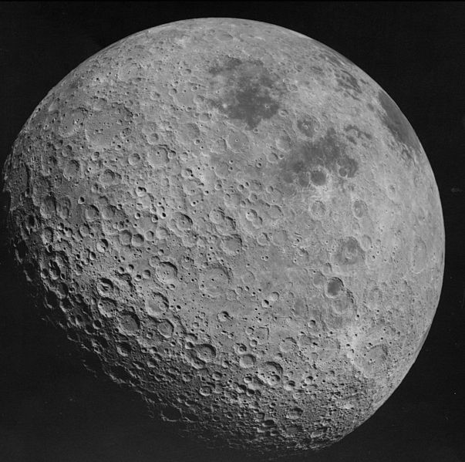
nucLIAR 核騙
far side of the Taiwan
STRESS TEST reports

Slide 2
Lessons learned from the Fukushima? 福島核災後我們學到了什麼？
Message from Commissioner Kenzo Oshima of Japan Nuclear Regulation Authority in the ENSREG meeting, Brussels, June 11, 2013
2013年6月11日日本原子力規制委員會委員大島賢三在布魯塞爾歐盟核能管制機構委員會中傳達的訊息。

Slide 3
If we don’t pay attention – even worse 如果我們不注意，台灣會更慘

Slide 4
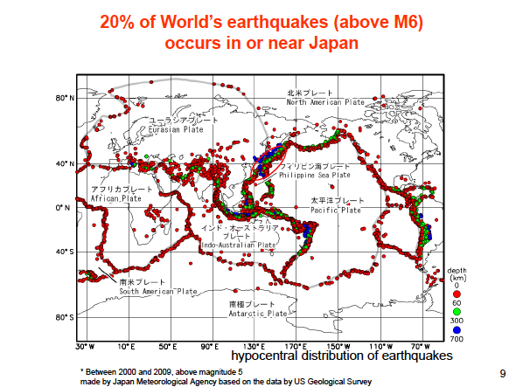
Taiwan is sitting on this EARTHQUKE CHAIN REACTION 台灣也在這個地震連鎖反應上

Slide 5
Even worse – higher density and near distance 甚至更嚴重 – 更高的密度與更近的距離

Slide 6
如果還有明天…

Slide 8
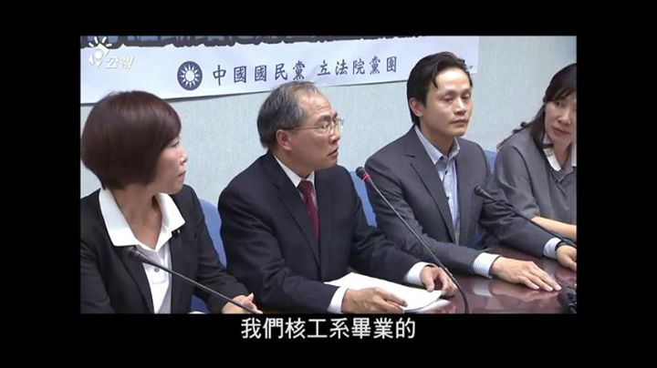
Dr. Tsai Chunhong tearing speech

Slide 9
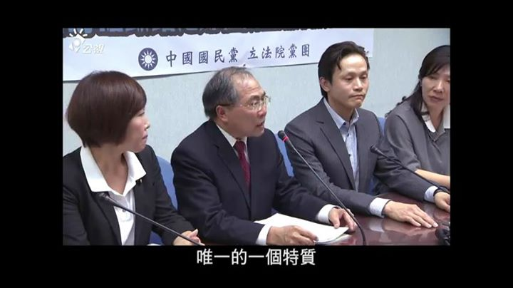
To ask for restart of the broken RV anchor bolts crippled Guosheng NPP

Slide 10
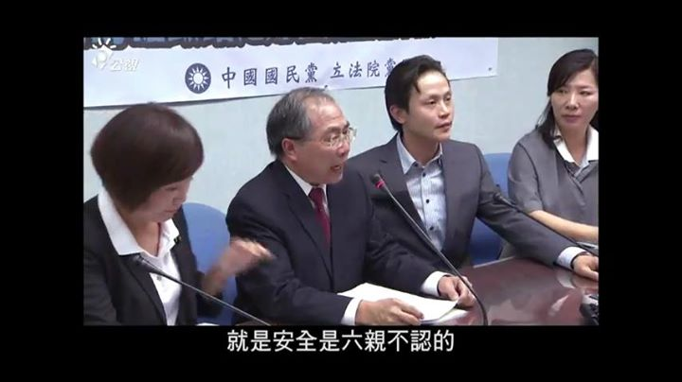
in the KMT Party Office in the Legislative Yuan

Slide 11
Do you know all NPPs and National Stress Test Reports are prepared by INER of AEC? And the Control Yuan made official report against the kinship between AEC, INER and Taipower. 各位同行審查委員，台灣核電廠壓力測試與國家壓力測試報告，都是由原子能委員會核能研究所（核能監督機構）寫的你們知道嗎？監察院也糾正這種不當行為。

Slide 12
Broken Anchor Bolt in the 1st Unit of Guosheng NPP

Slide 13
Broken Anchor bolt of 2nd Unit of Guosheng NPP

Slide 14
All bolts are related

Slide 15
How about the anchor bolts installation in the Longmen NPP?

Slide 16
Anchor bolts installation in the Longmen NPP, 2005

Slide 17
Incredible MEASUREMENT

Slide 18
Incredible MEASUREMENT

Slide 19
NICE SHOOT

Slide 20
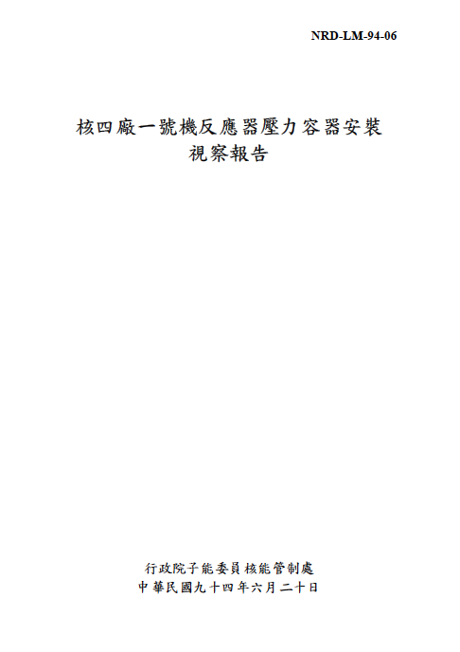
The report was there
http://www.aec.gov.tw/upload/1125467610NRDLM9406-2.pdf

Slide 21
http://www.aec.gov.tw/upload/1125467610NRDLM9406-2.pdf
Report been erased

Slide 22
NO TOILET IN THE CONSTRUCTION SITE, PET BOTTLES SHOWN ON THE CONTAINMENT WALL

Slide 23
Cut off rebar from the containment wall

Slide 24
It happened everywhere…

Slide 25
Those THINGS happen here

Slide 26
Do you want to know how deep is the rabbit hole?

Slide 27
WATER, WATER, EVERYWHERE

Slide 28
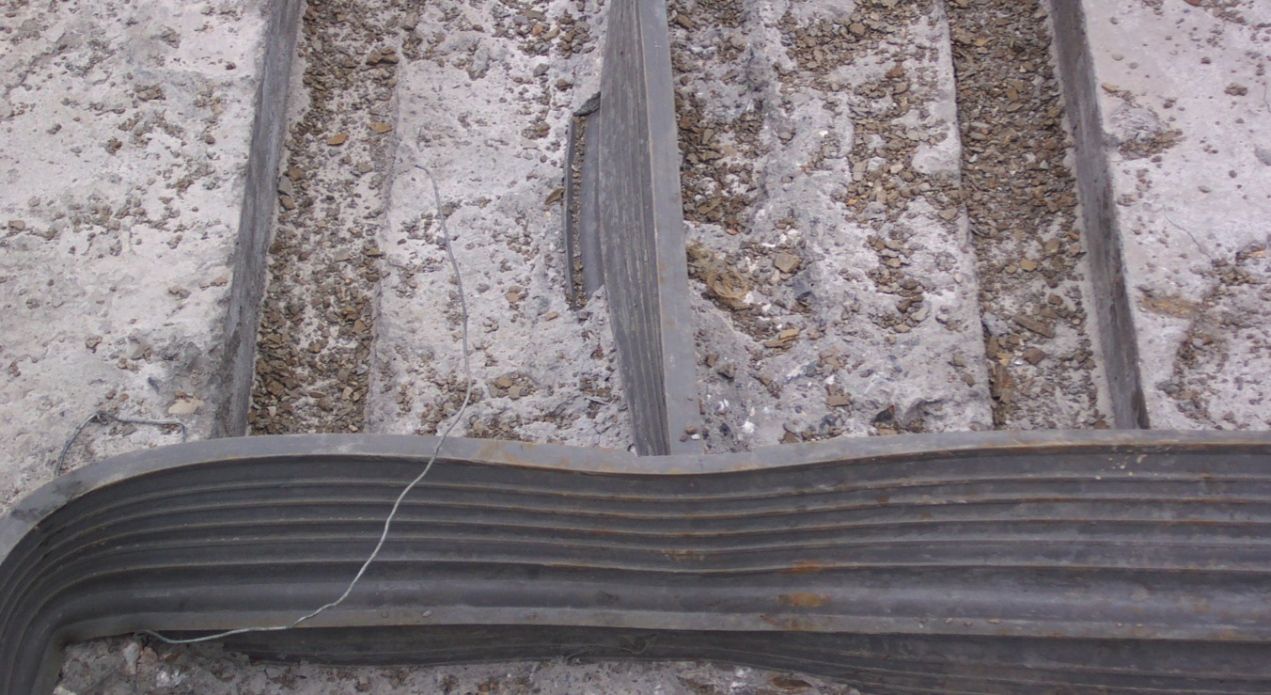
It can be water-proof???
Notes:
循環抽水機是核電廠反應爐重要的設施，結構工程的止水帶就如同防水手錶的密封橡膠環，如果遇到下雨、颱風、海嘯，抽水機房進水，抽水機就會失效，反應爐就無法得到供水，而導而爐心融毀。
從現場照片看來，不但工程㗊質粗糙、隨偒，而且止水帶的材料與水泥混凝土也有很大的問題。

Slide 29
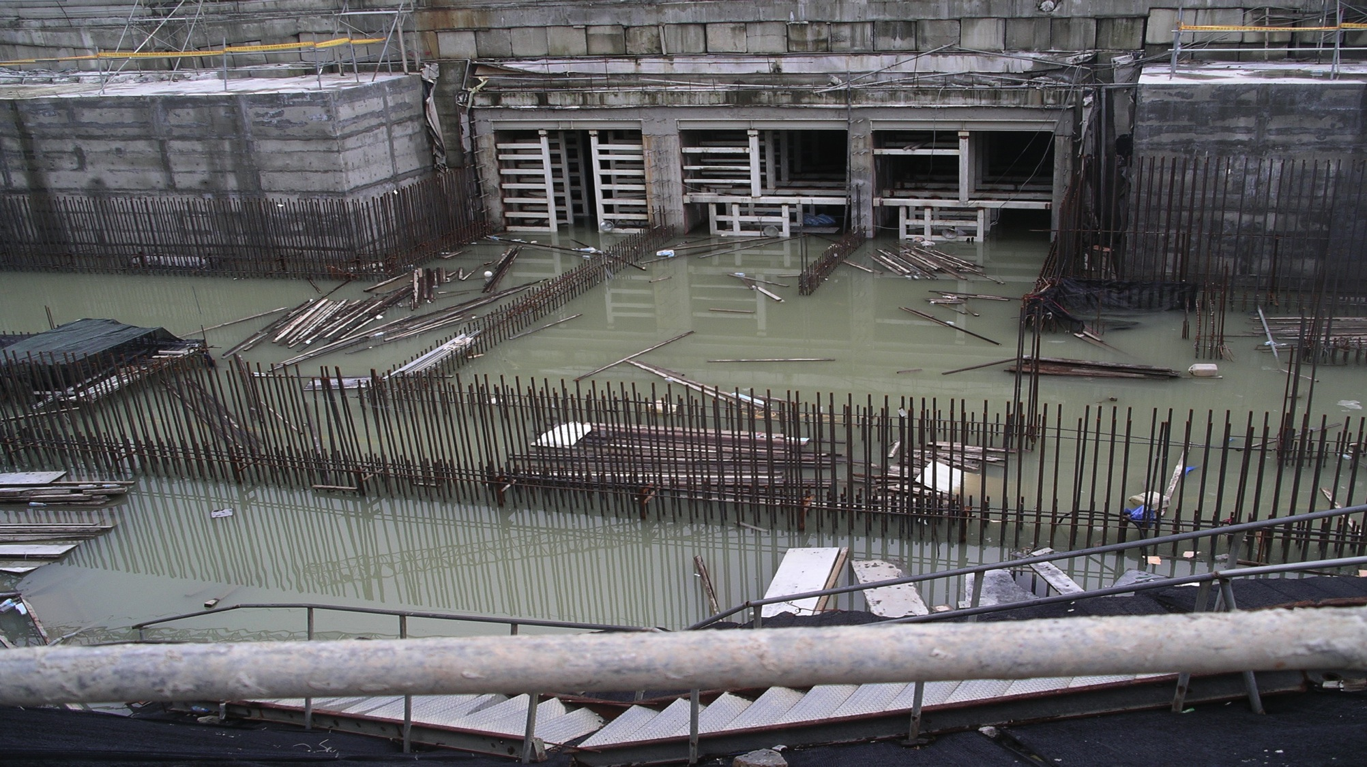
If it happened, it will happen again…
Notes:
所以核四廠經常進水，成了泡水電廠。核四的防水工程都沒有做好，如此明顯的缺失，發生許多次，現在號稱完成了95%，但只要0.0001%的缺失，就會造成核災。

Slide 30
Many reports used to here “Violations and Improvement Opportunities”
http://www.aec.gov.tw/category/%E6%A0%B8%E8%83%BD%E5%AE%89%E5%85%A8/%E9%9B%BB%E5%BB%A0%E9%81%95%E8%A6%8F%E8%99%95%E7%BD%B0%E6%A1%88%E4%BB%B6/3_23.html

Slide 31
THERE IS NO EVIDENCE FOR EFFECTIVE CORRECTIVE ACTION IN MORE THAN THOUSANDS REPORTS EXCEPT CONSISTANT MISTAKES, VIOLATIONS, HUMAN ERROS, LACK OF TRAINING, MALPRACTICES AND MALFUNCTION ALL TIME… 在上千份的違規、注改事項中，沒有任何有效的改正證據，只有不斷的錯誤重複發生 …

Slide 32
核電廠事故的浴盆曲線
Bath Tub Curve of Nuclear Power Plant
核電廠設計壽命30年
失效率 failure rate
夭折
壯年
老年
核二
無限期延役
核四
核三
核一
福島Fukushima
車諾比 Chernobyl
TMI
時間 Time

Slide 33
Many are missing or erased…

Slide 34
Far side of the moon
If the peer review team can not read Chinese, how can you find out truth?
Or just PAPER REVIW, NOT PEER REVIEW.
WOULD YOU GUARANTEE ANYTHING AFTER THE PEER REVIEW?

Slide 35
Or, we are witness worst than Fukushima accident in Taiwan getting closer and closer to shut world nuclear industry down?
Stop AEC/TAIPOWER lying and hiding

Slide 36
CITIZEN WATCHING YOU
取材自公民1985行動聯盟

