Slide 1

STRESS TESTS and
TAIWAN
PEER REVIEW PROCESS
Entrance Meeting
New Taipei City, September 23th 2013

Slide 2
Contents
Nuclear Safety in Europe
Nuclear Stress Tests in Europe
Nuclear Stress Tests Taiwan

Slide 3
Nuclear Safety in Europe (1)
Is promoted and harmonized by
National regulators
  WENRA (EU-MS(nuclear) + CH)
European Commission
  ENSREG (EU-MS(nuclear + non-nuclear))

Slide 4

The European Nuclear Safety Regulators Group (ENSREG) is
an independent, authoritative expert body created by the European Commission.
It is composed of
- senior officials from the nuclear Regulators of all nuclear + non-nuclear 28 Member States in the European Union and
- representatives of the European Commission.
Gives advices to the European Commission to establish
continuous improvement and to reach a common understanding
in the area of nuclear safety.

Slide 5

Western European Nuclear Regulators Association WENRA
is a network of Chief Regulators of all EU-MS with nuclear power plants + Switzerland.
Produces reference documents for the harmonization of nuclear safety and
promotes exchanging of experience and discussing of safety issues

Slide 6


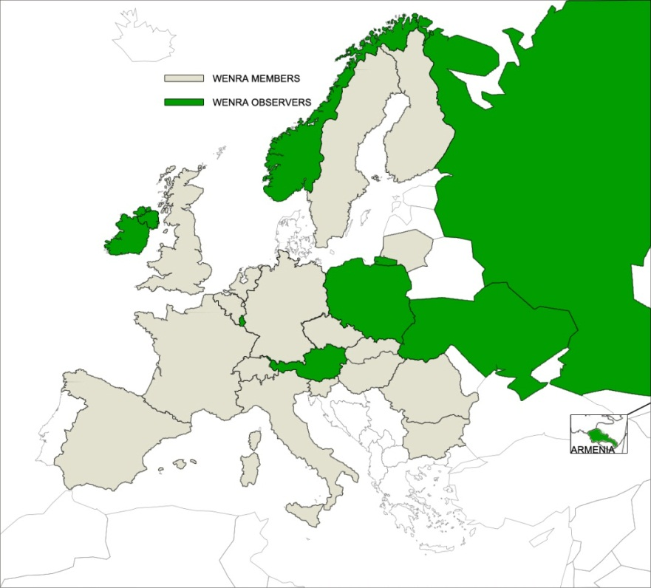
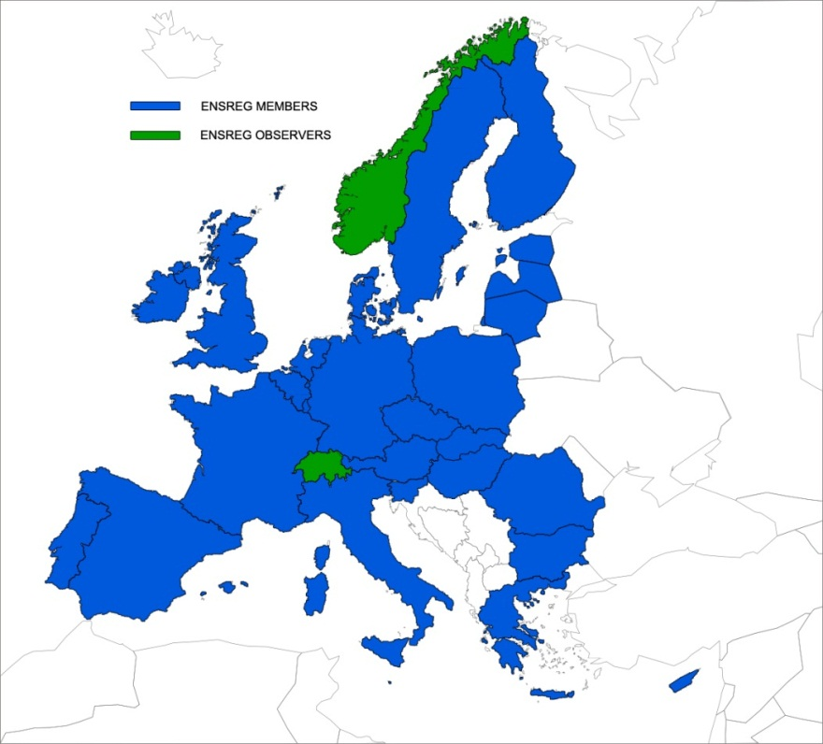
Cooperating States
.

Slide 7
Nuclear Safety in Europe (2)
The licensee has the prime responsibility for the safety of its nuclear power plants
Nuclear safety is a national responsibility
However, national Regulatory Frameworks have to comply with common global + European Safety Requirements and Guidelines, e.g.:
  Global: IAEA Safety Fundamentals, CNS
  EU: EU Nuclear Safety Directive

Slide 8
EU Nuclear Safety Directive (2009)
EU-wide legally binding framework
Reflects international instruments:
  Convention on Nuclear Safety
  IAEA Safety Fundamentals
Content:
  Establishes national
  responsibility for nuclear safety
  Reinforces regulatory
  authorities
  Transparency (principles)

Slide 9
Contents
Nuclear Safety in Europe
Nuclear Stress Tests in Europe
Nuclear Stress Tests Taiwan

Slide 10
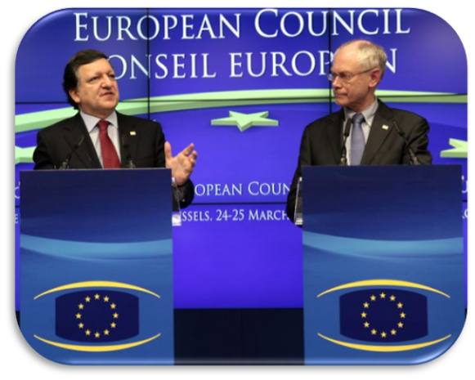

Stress Tests: Origin
11/03/2011 Fukushima accident
25/03/2011 European Council requested
comprehensive and transparent risk and
safety assessments ("Stress Tests")
April/May Stress Tests designed by
and
25/05/2011 Stress Tests specification
published
01/06/2011 Start of Nuclear Stress Tests
in Europe

Slide 11
Stress Tests: Steps in Europe (1)
A Nuclear stress tests – June 2011 to April 2012
reassessments of all nuclear power plants
by the licensees
licensee reports
assessment of the reports of the licensees
by the national regulator
national report
peer review of the national reports and visit of each country with NPPs and hereby visiting of one site
by the peer review team
country report for each country and
one summary report.

Slide 12
Stress Tests: Features
Go beyond safety evaluations during the licensing process
and periodic reviews
The aim: to assess whether safety margins are sufficient to cover various unexpected events (extreme external impact)
Conducted on a voluntary basis
Transparency:
  All reports have been published (www.ensreg.eu)
  Stakeholders were closely involved
  (public meetings, web-consultation)

Slide 13
Stress Tests: Conclusions
Stress tests are an essential stage of the process of improving European nuclear safety, which is due to continue.
Implementation of recommendations and concrete measures are a national responsibility:
  National action plans in all participating countries
Based on lessons learned from Fukushima, EU institutions will take decisions on common safety policy and legislative or non-legislative initiatives:
  Commission Communication to the European Council on the results of the stress tests (4.10.2012)

Slide 14
Stress Tests: Follow-up Steps
B Follow-up fact finding site visits - September 2012
Visit of a second site in several countries
by peer review teams,
to gather information about the measures, which have already been taken.
fact finding site visit report
C National action plans workshop – April 2013
Peer review of national action plans
by peers via a common discussion during a one week workshop in Brussels
Rapporteurs reports for each country
and one summary report

Slide 15
Principles of the Peer Reviews
Experience
regulators review regulators
Committment to internationally accepted safety principles
Mutual learning (mutual information transfer)
between the reviewers and their organizations and the reviewed organization (mutual information transfer
Independence
Transparency
by public consultation and comprehensive information via internet

Slide 16
Contents
Nuclear Safety in Europe
Nuclear Stress Tests in Europe
Nuclear Stress Tests Taiwan

Slide 17
Commitment
Taiwan declared
to conduct Comprehensive Risk and Safety Assessments (Stress Tests) of all of its NPPs as follow-up to the Fukushima accident,
that these stress tests shall be carried out analogue to the stress tests done in Europa
invited the European Commission to organise a peer review of its Stress Tests

Slide 18
Objective of Stress Tests
Targeted reassessment of safety margins and robustness of plants, in respect to the topics:
  Natural Hazards (earthquake, flooding, extreme weather, volcanism)
  Loss of Safety Systems
  Severe Accident Management
Improvement of Plant Safety taking into account the lessons learned from Fukushima
Stress test is not an in-depth assessment of all safety issues of the NPPs
Mandate does not include security issues.

Slide 19
Bases
Bases for the whole process and especially the peer review are:
the ENSREG Specification and
the conclusions of the conducted European peer reviews published in
  ENSREG Peer Review Report of 25 April 2012
  Compilation of Recommendations and Suggestions from the Peer Review of the European Stress Tests of 26 April 2012
Communication from the European Commission
of 4 October 2012
National Action Plans Workshop of
22-26 April 2013 in Brussels

Slide 20
Conduct of the Peer Review (1)
The review process will be conducted as far as possible in the same way as it was done in Europa:
Same objectives, scope and approach
As a review of experts of European regulators reviewing the special actions of the Taiwanese regulator in the aftermath of the Fukushima Daiichi accident

Slide 21
Conduct of the Peer Review (2)
Independent of interests of concerned or interested parties or stakeholders, but taking into account broad scope of views (regulator, NGOs, utility) with
  Participation of the public
  by public consultation and posting of all important information via our websites
  High Transparency

Slide 22
Transparency - General
To enhance the credibility of and the confidence in the nuclear regulatory bodies and to strengthen their independence from political and economic influence nuclear regulation has to be as transparent as possible.
For the Taiwan Peer Review high transparency
vis-à-vis the public is a key principle.
Based on activities by:
European Commission and the Peer Review Team
and the National regulator (AEC)

Slide 23
Transparency – EC and Peer Team
The European Commission and its Peer Review Team
informed beforehand interested groups and organizations about the public consultation via internet
offered on the ENSREG website a 2-months lasting public consultation and gave to all interested parties/individuals the possibility to post comments and questions in English language
posted on an additional ENSREG website interesting documents and information
had continuously contact to interested groups and stakeholders, and
has a meeting in Taiwan with interested
groups and stakeholders

Slide 24
Thank you for your attention

